Slide 1

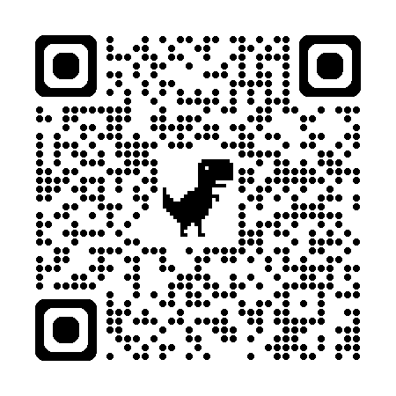
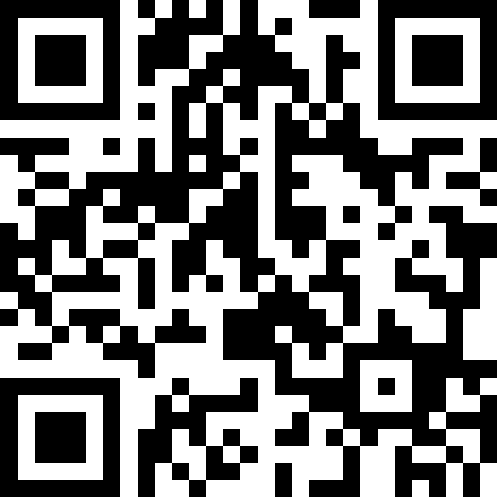
自然語言處理與應用 Natural Language Processing and Applications
LLM API Tutorial
Instructor: 林英嘉 (Ying-Jia Lin)
2025/05/12
Course GitHub
Slido # NLP_0512

Slide 2
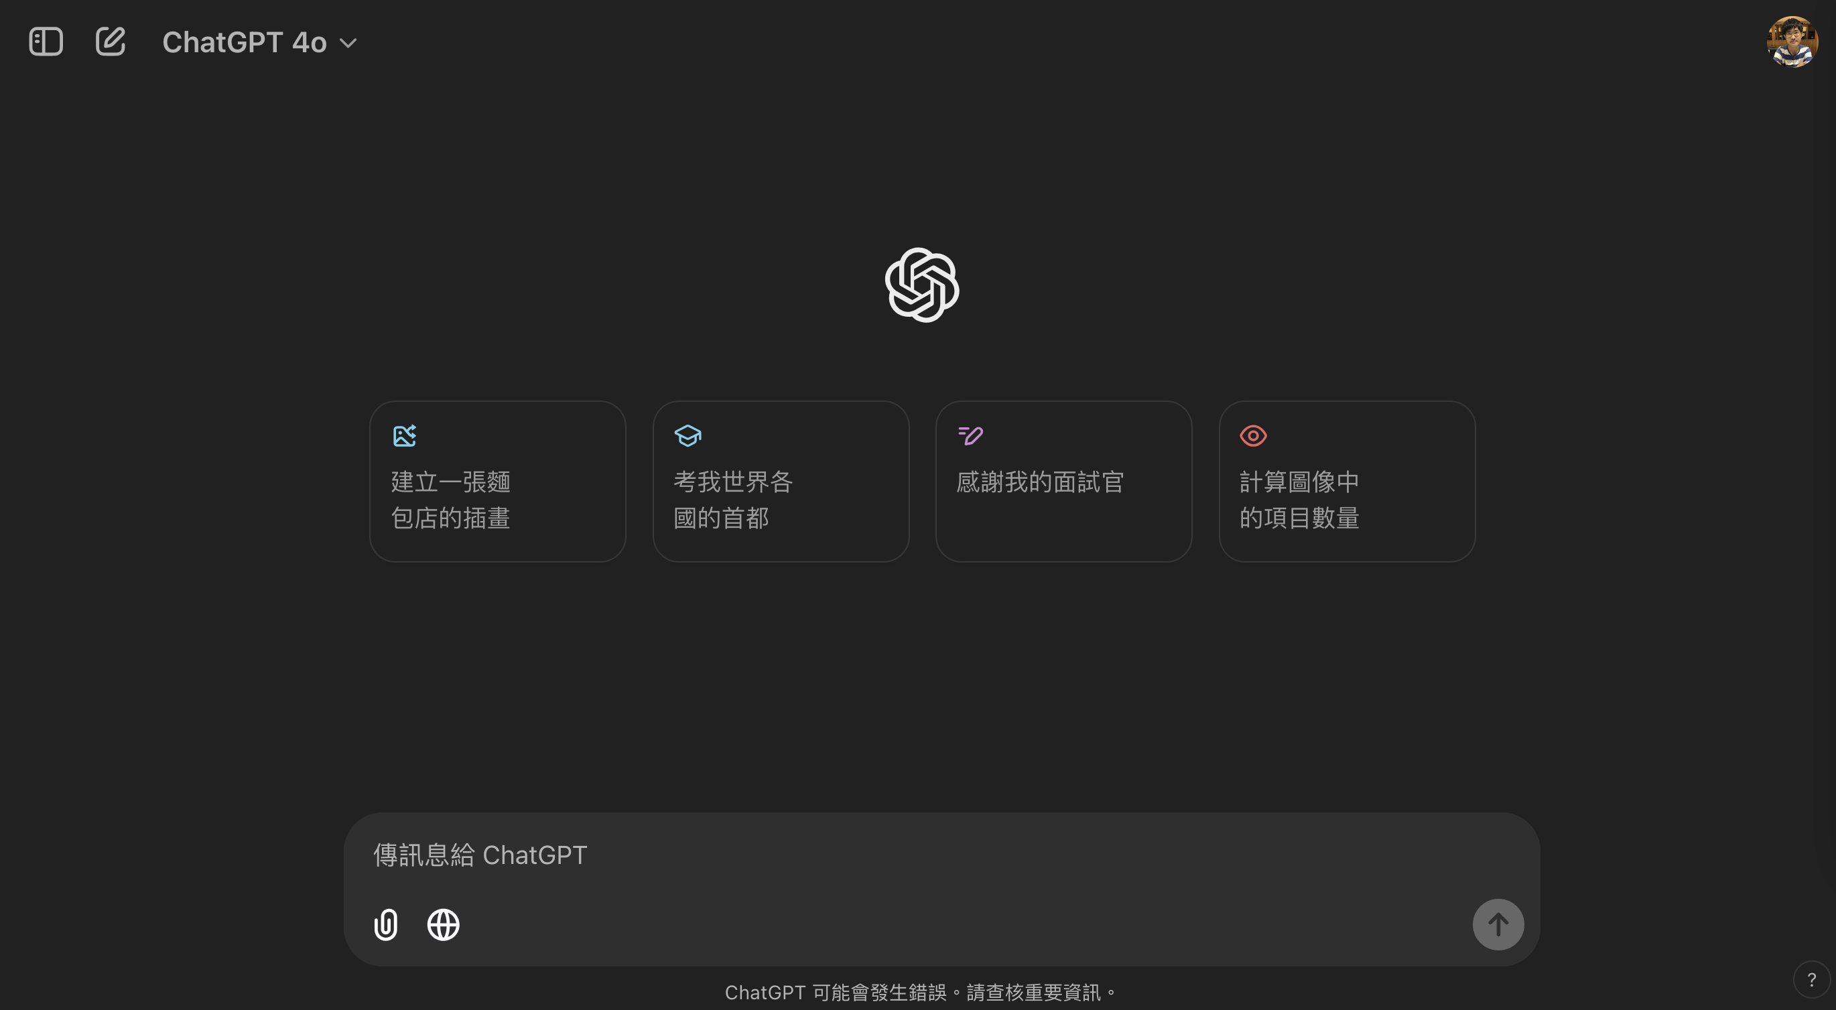
Why do we need to use API?
It’s slow if you want to use ChatGPT for NLP tasks by manually copying and pasting from the webpage.
If you use ChatGPT from the webpage to test data, “Too many requests in 1 hour. Try again later.” may occur.

Slide 3
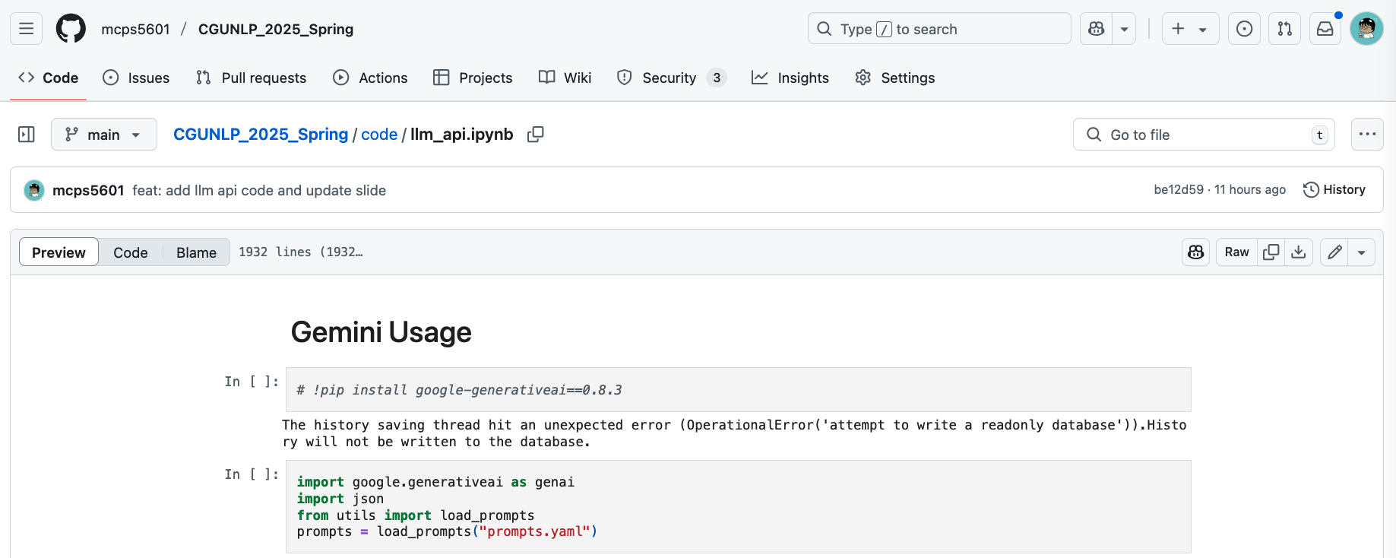
Code Example

Slide 4
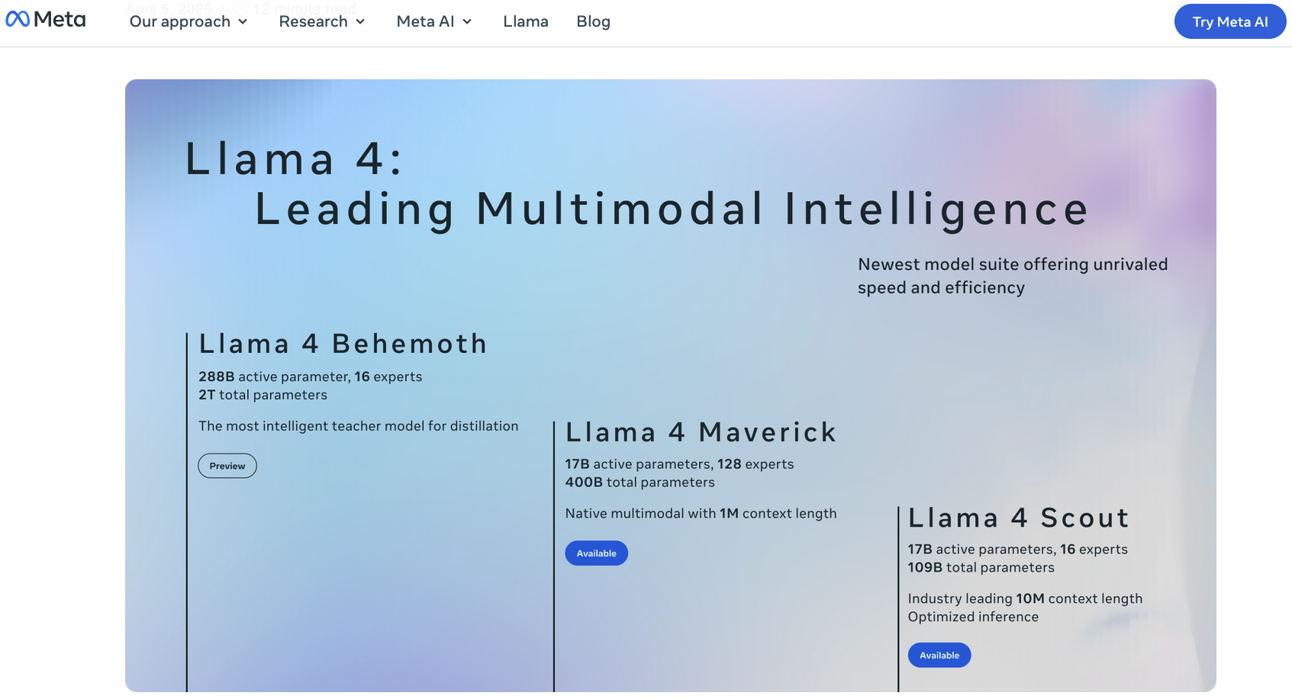

Slide 5
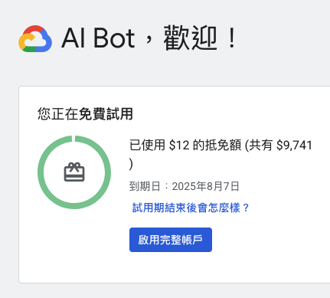
註冊 Google Vertex
https://cloud.google.com/vertex-ai?hl=zh-TW

Slide 6
進到控制台
https://console.cloud.google.com
右邊導覽選單
Vertex AI
Model Garden

Slide 7
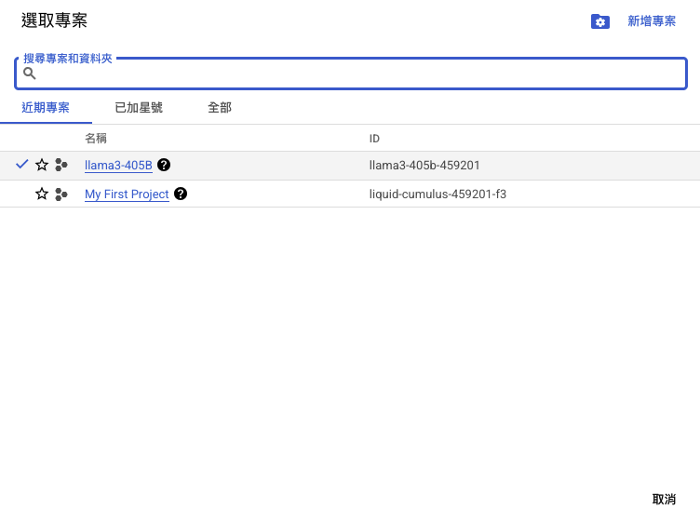
選取專案
ID 等等會用到

Slide 8
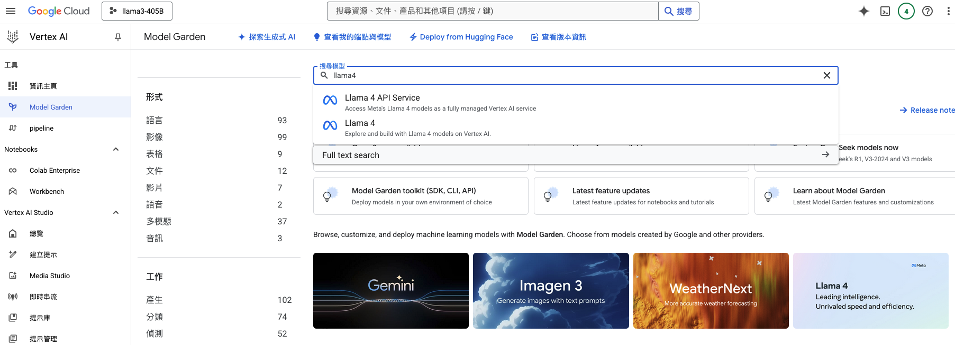
搜尋llama4
點這個

Slide 9
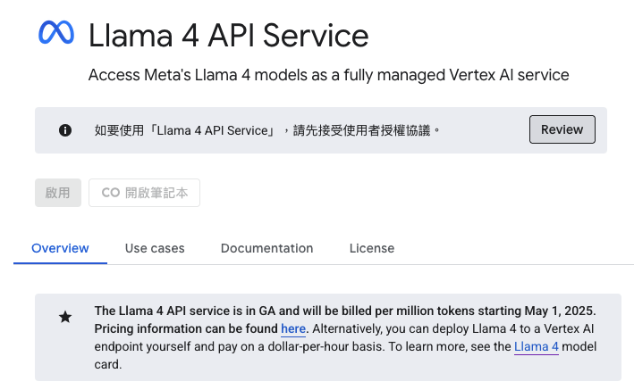
閱讀 EULA 後點啟用

Slide 10
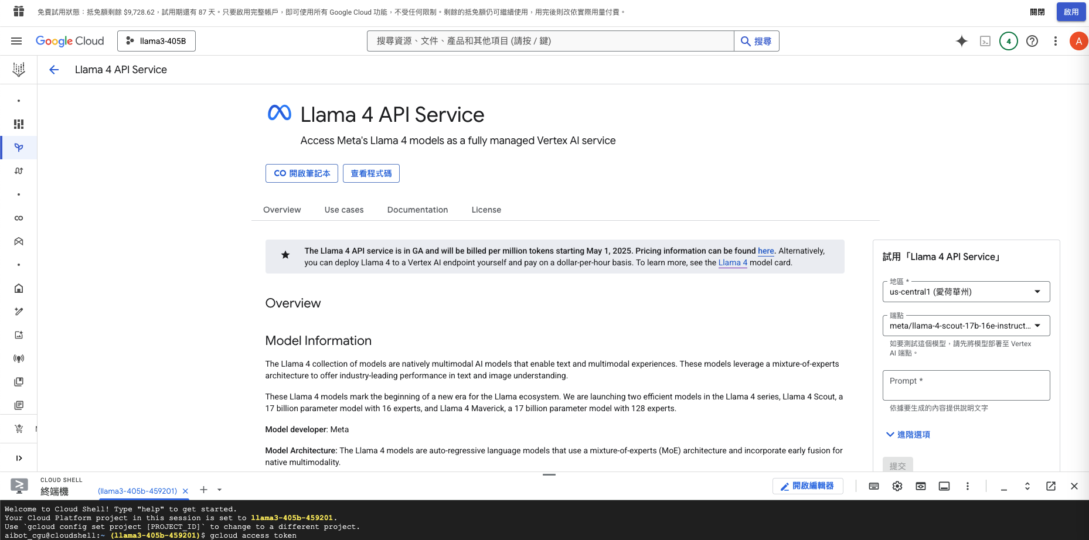
打指令在終端機：gcloud access token
把 API Key 複製起來！

Slide 11
Thank you!
Instructor: 林英嘉
✉️ yjlin@cgu.edu.tw
TA: 吳宣毅
✉️ m1161007@cgu.edu.tw

